Slide 1

DATA AUGMENTATION
Mustafa Hasan (TL)
Ashu Hasan, Kartik Sharma, Kapil Dev Sharma, Rajat Kaliya
Project Presentation By
Session 2020-2021
ConsoleLancer, No.50,4th cross,4th Main, Vinayaka Layout,Bhattarahalli, Bangalore,Karnataka-560049

Slide 2
Introduction to the Project:
The DATA AUGMENTATION is a simple desktop application
developed using Python Language. The Project is based on the concept of Image Processing. Talking about the system, a user has to pass through a login system for using its features. The user fill some basics info like first name, last name, email address and phone number for sign in. A user can choose any filters according to there need. Its allow to you generate set of image according to user requirement.

Slide 3
Project Goals:
Help to train AI
Help to generate ‘more data’ from limited data
To avoid overfitting.
Easy to use
Save user’s time

Slide 4
Software Requirements:
Technology
MYSQL: For database we are using MYSOL, you can use any version of MYSQL
Pycharm : This project will be tested in Visual Studio 2015 and 2017
XAMPP Server: For connecting data, we need XAMPP server
Operating system: Window 7 or above
PYTHON: All the business logic, we have written in python
MYSQL : We have used MYSOL database in this project
TKINTER: All the layout designed in TKINTER
OpenCV : All the filters designed in OpenCV

Slide 5
Name of component specification
Hardware Requirements:
Processor: Intel(R) Core(TM) i3 or above
Processor Speed: 1.0GHZ or above
RAM: 2 GB RAM or above
Hard Disk: 512 GB hard disk or above

Slide 6
Gant Chart
Researching
10 November 2020
Planning
21 December
Designing
7 January
Coding
7 January
Implementation & Testing
23 January
Documentation
20 February

Slide 7
User Use case
Sig In
Read More
Sign UP
Generate Data
Download Data

Slide 8
Admin Use case
Read More
Sig In
Check User
Download User Data

Slide 9

USER PHASE
Sign In
ID Or Number
User Sign In
Sign Up
Read Me
Password

Slide 10
User Sign Up
Sign In
Confirm Password
User Sign Up
Sign Up
Read Me
Password
Answer
First Name
Last Name
Phone Number
E-mail ID
Security Question

Slide 11
User Dashboard
User Dash Board
Upload
Show Feature
Select Path
Select Filter
Hide Features
Hide Filter
Download

Slide 12
Admin Sign In
Sign In
Admin Sign In
ID
Read Me
Password

Slide 13
Admin Dashboard
Show User
Admin Dashboard
User Name
Sign Out
User Number
Download
User ID

Slide 14
Read Me
Read Ne
User Sign In
Admin Sign Up

Slide 15
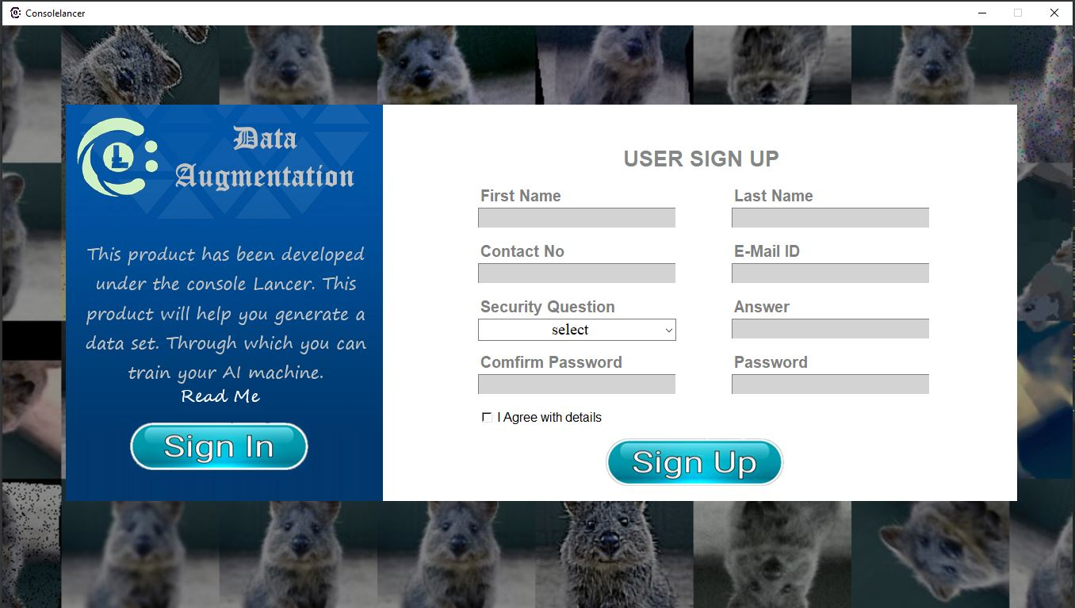

Slide 16
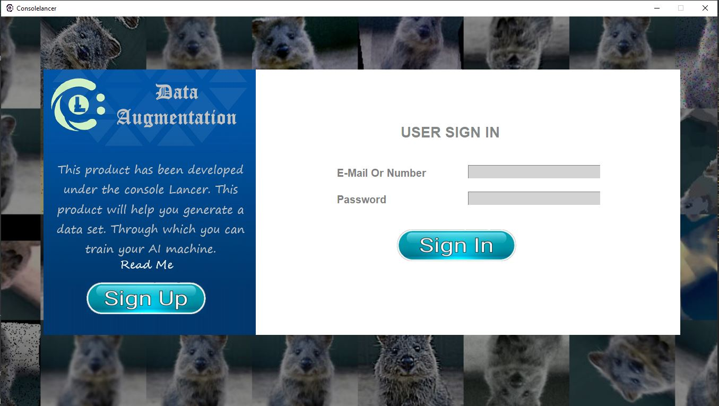

Slide 17
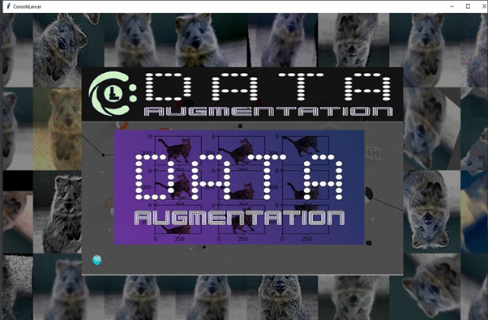

Slide 18
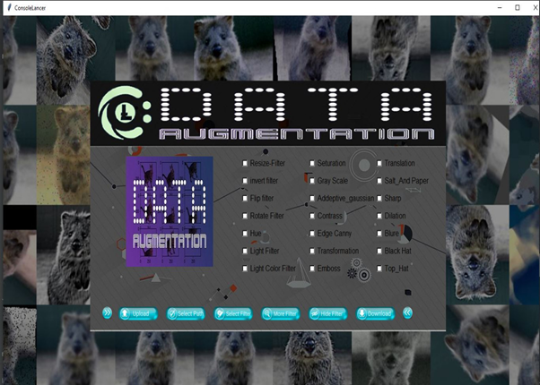

Slide 19
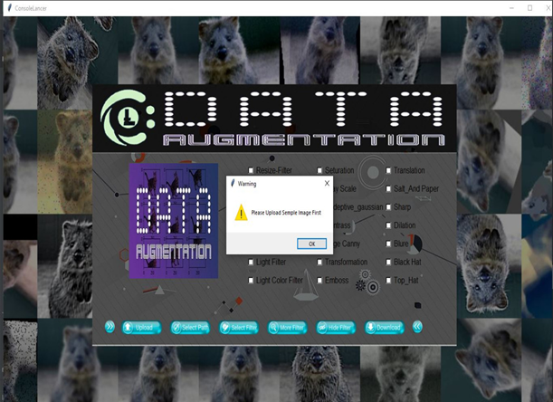

Slide 20
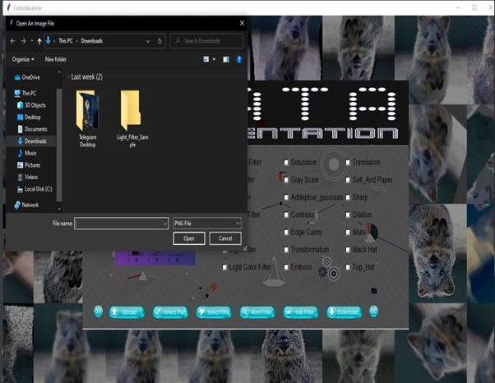

Slide 21
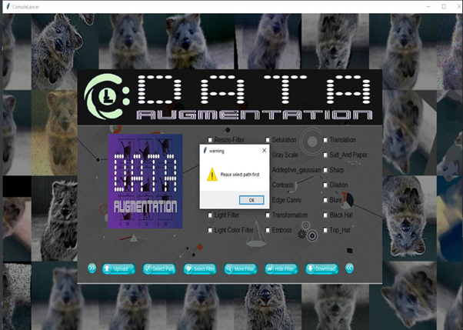

Slide 22
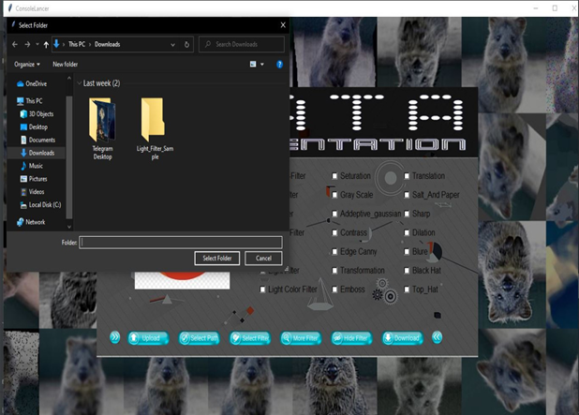

Slide 23
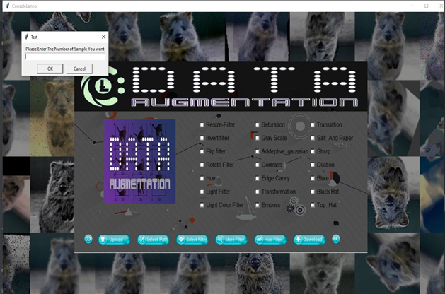

Slide 24
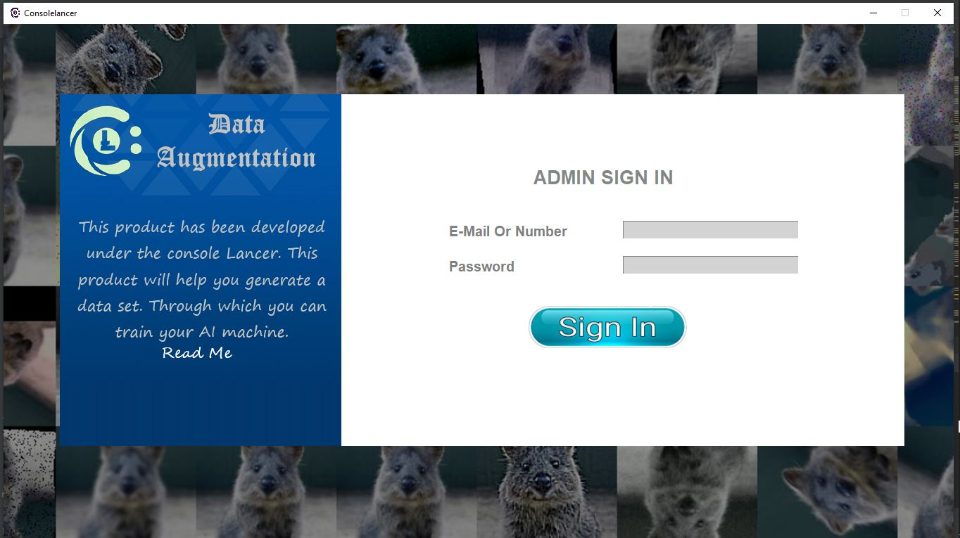

Slide 25
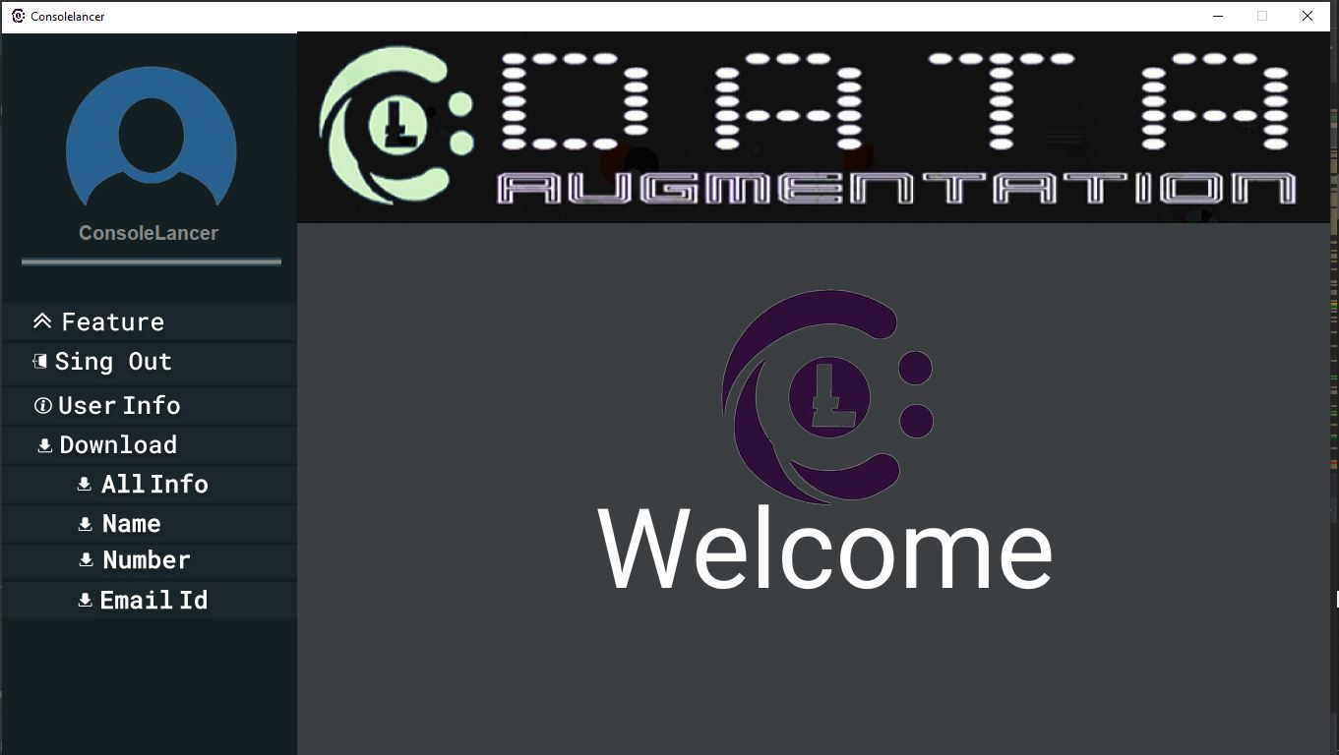

Slide 26
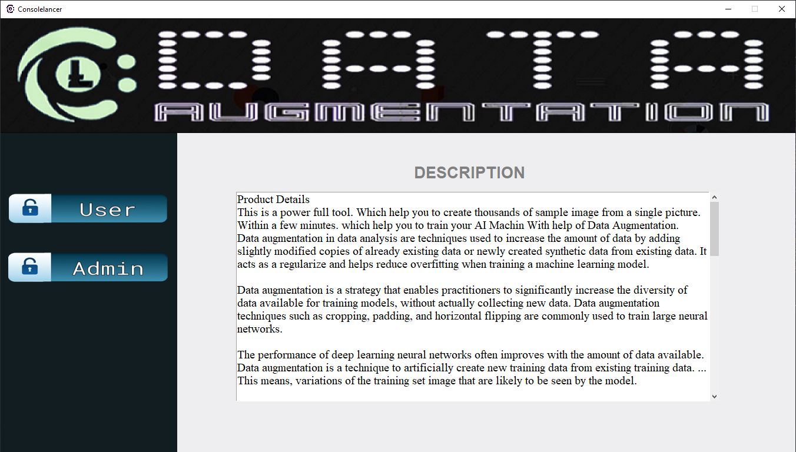

Slide 27
Thanks To ConsoleLancer
Behalf Of
Mustafa Hasan (TL), Ashu Hasan
Rajat Kaliya, Kartik Sharma
Kapil Dev Sharma

